Slide 1
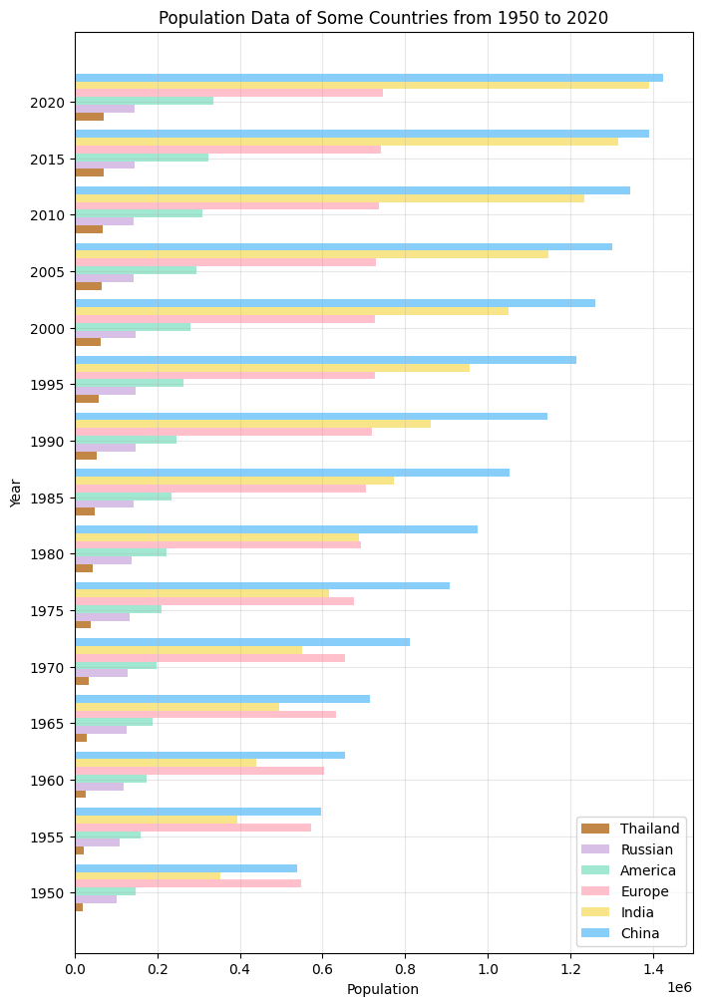
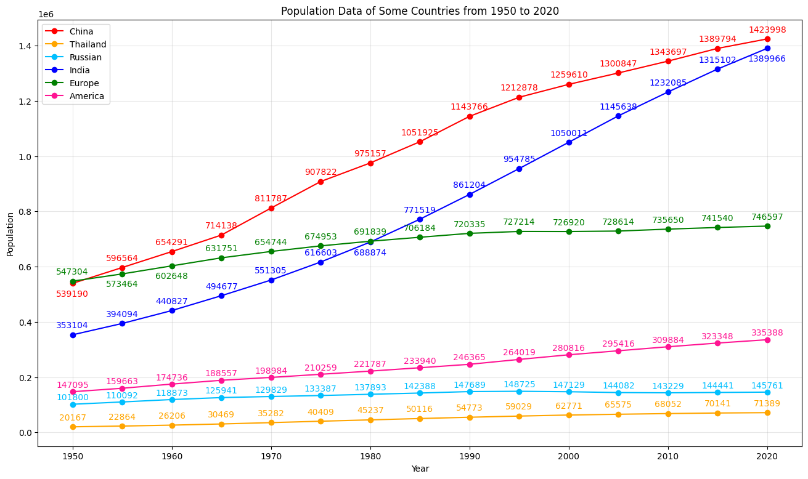
Both figures show population data of some countries from 1950 to 2020.
The line plot focuses on showing the trend of population changes over time, while the bar plot focuses on showing the differences in population in different countries in the same year.
Overall, as the year increases, the country’s population gradually increases.
For each year, the population rankings between countries remain essentially unchanged.
Shiyun Zhang
Notes:
Hello everyone, I’m Shiyun Zhang. My presentation today is about the Visualization of Population Data of Some Countries from 1950 to 2020.
Here we can see that Both figures show population data of some countries over years.
The line plot focuses on showing the trend of population changes over time,
while the bar plot focuses on showing the differences in population in different countries in the same year.
Here are some information we can get from the figures:
Overall, as the year increases, the country’s population gradually increases.
From the line plot, we can see that populations in India and China continue to grow significantly, while other countries tend to remain stable.
From the bar plot, we can see that for each year, the population rankings between countries remain essentially unchanged. Except India's population surpassed Europe's in 1985.

Slide 2
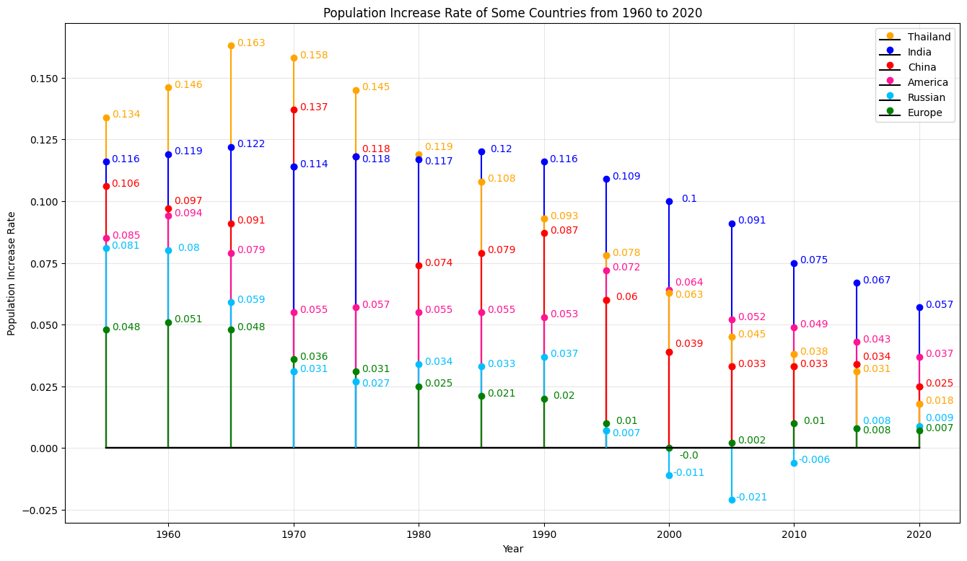
Conclusions:
Through these three figures, people can more intuitively and clearly understand the changing trends of population data of different countries in different years.
Dataset:
https://www.kaggle.com/datasets/shivd24coder/worldwide-population-data
Github link:
https://github.com/shz173/2415-final-project
This stem plot shows the trend of population growth rate in different countries from 1960 to 2020.
Overall, as the year increases, the population growth rate gradually decreases.
Positive values indicate that the population has increased during this decade, while negative values indicate the opposite.
Shiyun Zhang
Notes:
This stem plot here shows the trend of population growth rate in different countries from 1960 to 2020.
In this figure, Positive values indicate that the population has increased during this decade, while negative values indicate the opposite.
We can find that: Overall, as the year increases, the population growth rate gradually decreases.
Through these three figures, people can more intuitively and clearly understand the changing trends of population data of different countries in different years.
And following is the dataset link and the github link of my work.

